Slide 1
INFORMING, EDUCATING, EMPOWERING FAMILIES
617-236-7210 | www.fcsn.org | fcsninfo@fcsn.org

Slide 2
Assessments and Evaluations
School Liaison Cohort Meeting
January 29, 2020

Slide 3
What do you want to learn about
Assessments and Evaluations?

Slide 4
Learning Objectives:
Assessments, Tests and Evaluations:
Understand the Definitions and Types
Review Federal and State Laws about Evaluations
Learn About Common Assessments:
Intelligence
Reading
Math
Neuropsychological
Understand how to read and interpret data from a standardized test on the normal distribution,
and explain it to parents

Slide 5
Assessments Can Feel Intimidating
Reports are often written with large amounts of statistical information that can be confusing
Reading level of reports can be very high.
The Wechsler Intelligence Scale for Children (WISC-IV) gives a sample report online. The summary section scored at the College-Difficult level using the Flesch-Kinkaid Readability Tool
Some terminology is emotionally loaded for parents:
Testing refers to the statistical term the Normal Distribution or Bell Curve. However, the word “normal” can be problematic in special education.

Slide 7
I. Definitions, Laws and Regulations

Slide 8
Why do Assessments and Evaluations?
Assessments and Evaluations help to answer questions including:
Is the student eligible for an IEP? What areas should services and accommodations be provided in the IEP?
How much can the student do the student compared to other students the same age/grade?
Has the student made progress, stayed the same or regressed in the current program? By how much?

Slide 9
Definitions
Testing, Assessment and Evaluation are often used interchangeably and not all definitions agree.
Testing is the administration of specifically designed and often standardized educational and psychological measures of behavior and is a part of the assessment process.
Assessment encompasses many different methods, one of which is using tests.
Evaluation describes the complete process in which the IEP team develops and considers the data on a child’s strengths, weaknesses and disabilities and what is necessary to address them.
Laws and Regulations Regarding

Slide 10
Laws and Regulations Regarding Evaluations
Federal IDEA 2004:
In conducting the evaluation, the public agency must—
(1) Use a variety of assessment tools and strategies to gather relevant functional, developmental, and academic information about the child, including information provided by the parent, that may assist in determining—
(i) Whether the child is a child with a disability under §300.8; and
(ii) The content of the child’s IEP, including information related to enabling the child to be involved in and progress in the general education curriculum (or for a preschool child, to participate in appropriate activities)

Slide 11
Laws and Regulations Regarding Evaluations
(2) Not use any single measure or assessment as the sole criterion for determining whether a child is a child with a disability and for determining an appropriate educational program for the child; and
(3) Use technically sound instruments that may assess the relative contribution of cognitive and behavioral factors, in addition to physical or developmental factors.
IDEA 2004 Sec. 300.304 Evaluation Procedures

Slide 12
MA Laws and Regulations on Evaluations
Upon consent of a parent, the school district
shall provide or arrange for the evaluation of the student by a multidisciplinary team within 30 school days.
The assessments used shall be adapted to the age of the student and all testing shall meet the evaluation requirements set out in state and federal law.
The school district shall ensure that appropriately
credentialed and trained specialists administer all assessments.
M.G.L. c. 69, § 1B; c. 69, §§ 1J and 1K, as amended by St. 2010, c. 12, § 3; c. 71, § 38G.

Slide 13
MA Laws and Regulations on Evaluations
(a) Required assessments.
An assessment in all areas related to the suspected disability.
An educational assessment by a representative of the
school district, including a history of the student's educational
progress in the general curriculum. Such assessment shall
include information provided by a teacher(s) with current
knowledge regarding the student's specific abilities in
relation to learning standards of the Massachusetts
Curriculum Frameworks and the district curriculum
An assessment of the student's attention skills,
participation behaviors, communication skills, memory,
and social relations with groups, peers, and adults.
Types of Assessments

Slide 14
Independent Educational Evaluations (IEE)
IEEs must be considered by the IEP team
Parents can obtain an IEE at their own expense
District can choose pay for IEE at any time
If the student/family meet certain criteria (eligible for free or reduced cost lunch, is a state ward, or the family's income is equal to or less than 400% of the federal poverty guidelines), the district must pay the entire cost of the IEE. IEE can be done for 16 months from the disputed evaluation
If family income between 400-600% of federal poverty guidelines, district must cost share with parents
If student/family does not meet these criteria, the district must pay or file with BSEA within 5 days and prove its evaluation was comprehensive and appropriate

Slide 15
Assessments and ELL Students
Delaying evaluation of English Language
Learners for a specific period of time
is not permitted
Assessments must be conducted in the
student’s native language
Assessments must be administered in
a non-discriminatory manner
All reports must be provided in the
parent’s native language
Qualified Interpreters must be present
at all Team meetings

Slide 16
Questions?

Slide 17
II. Types of Assessments

Slide 18
What are the most common types of disabilities for school-aged children
in Massachusetts?

Slide 20
Common Areas of Assessment
Cognitive Ability/Intelligence
Social Communication/Behavior
Achievement
Behavior/Emotional/Personality
Speech and Language
Combined Assessments:
Developmental Delay
Neuropsychological Evaluation

Slide 21
Types of Assessments
Cognitive Ability/Intelligence
Assess verbal and nonverbal reasoning, perceptual skills, attention, and memory
Examples: WISC-V, Woodcock-Johnson
Social Communication/Behavior
Assess communication and social interactions, unusual responses to sensory experiences, impairments with patterns of behaviors, interests and/or activities that are restrictive, repetitive or stereotypic
Examples: Autism Diagnostic Observation Schedule, (ADOS)

Slide 22
Types of Assessments
Achievement:
Assess academic skill development in math,
reading, and written language.
Examples: W-J Tests of Achievement
Young Children’s Achievement Test (YCAT)
Behavioral/Emotional/Personality
Evaluate an student’s behavior according to age-appropriate expectations , can include tests for ADHD, Executive Function
Example: Conners Parent/Teacher Rating Scale Achenbach Child Behavior Checklist

Slide 23
Norm vs. Criterion Referenced Tests
Norm-referenced tests are specifically designed to rank test takers on a “bell curve,” or Normal Distribution
Criterion-referenced tests measure whether students have achieved specified learning standards, learned certain material, or acquired specific skills and knowledge

Slide 24
Types of Assessments
Speech and Language:
Speech tests measure the student’s ability to
articulate sounds and speak intelligibly.
Examples:
Clinical Assessment of Articulation and
Phonology (CAAP)
The Apraxia Profile
Goldman-Fristoe Test of Articulation (GFTA)
Test of Minimal Articulation Competence

Slide 25
Language Assessments
Language tests measure a student’s ability to
understand and use language. Language consists of:
Syntax: accurate sentence structure
Morphology: the structure of words and parts of words, such as stems, root words, prefixes, and suffixes.
Semantics: the understanding and use of vocabulary
and concepts
Pragmatics: Measurement of how the student uses
his/her language to meet their social needs

Slide 26
Language Assessments
Examples of Language Assessments:
Expressive One-Word Picture Vocabulary Test (EOWPVT)
Receptive One-Word Picture Vocabulary Test (ROWPVT)
Comprehensive Receptive & Expressive Vocabulary Test Clinical Evaluation of Language Fundamentals- (CELF)
Test of Language Development Primary (TOLD)
Peabody Picture Vocabulary Test (PPVT)

Slide 27
Assessment of Developmental Delay
Assessed Across 5 Areas of Development
Physical development (fine motor skills, gross motor skills)
Cognitive development (intellectual abilities)
Communication development (speech and language)
Social or emotional development (social skills, emotional control)
Adaptive development (self-care skills)

Slide 28
Neuropsychological Evaluations
Neuropsychological Evaluations are done by a
PhD Psychologist
Tests can include:
Cognitive/Intellectual level
Language skills
Nonverbal or visual skills
Memory
Attention
Organization, judgment, planning
Academic skills
Emotional status including anxiety and depression

Slide 29
Example: Rey-Osterrieth Complex Figure
The Rey-Osterrieth Complex Figure is one test that
is frequently included in a neuropsychological
evaluation. It is used to evaluate:
Visuospatial ability
Memory
Attention
Planning
Working memory
Executive Function

Slide 30
Rey-Osterrieth Complex Figure

Slide 31
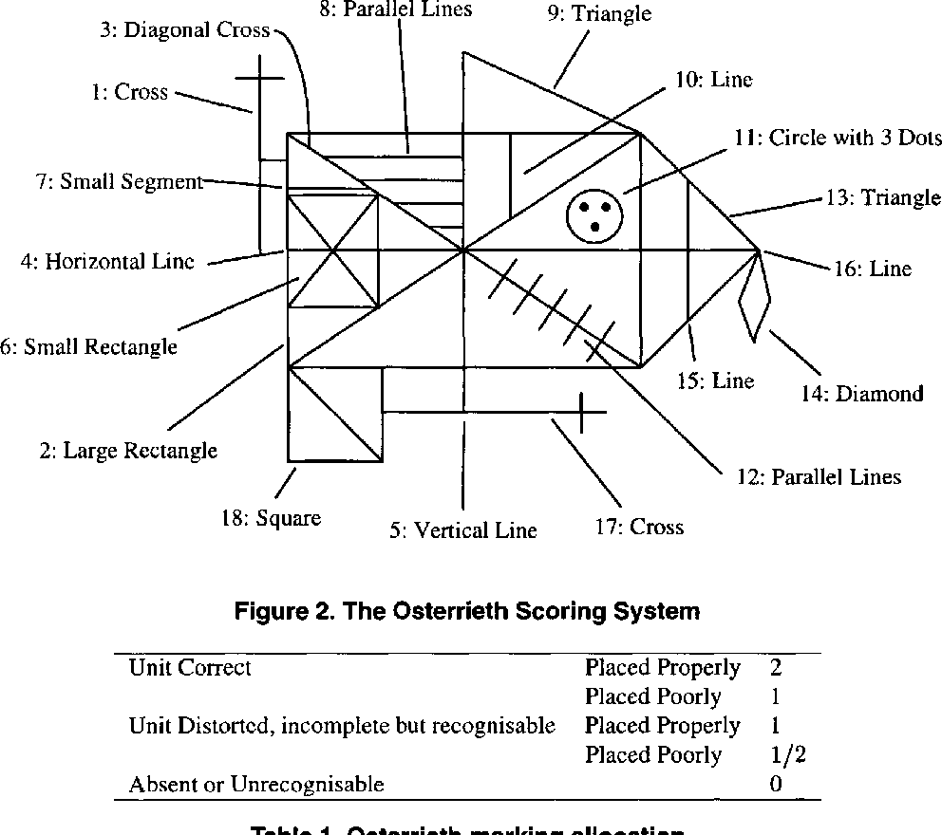
Example of Scoring : Rey-Osterrieth Complex Figure

Slide 32
Questions?

Slide 34
III. Test Example: WISC-V

Slide 35
Assessments for Cognitive Functioning:
WISC-V:
Administered to children ages 6 to 16.11 years
Measures a child’s intellectual ability and 5 cognitive domains that impact performance:
Verbal Comprehension
Visual Spatial
Fluid Reasoning
Working Memory
Processing Speed

Slide 36
WISC-V: Cognitive Domains
Verbal Comprehension measures the ability to
access and apply acquired word knowledge.
Ability to verbalize meaningful concepts
Ability to think about verbal information,
Ability to express himself using words.

Slide 37
Assessments for Cognitive Functioning:
Visual Spatial measures the ability to
evaluate visual details and understand visual spatial relationships in order to construct geometric designs from a model.
Visual spatial reasoning
Integration and synthesis of part-whole relationships
Attentiveness to visual detail
Visual-motor integration
Block Design: The student views designs and uses blocks to recreate each design
Visual Puzzles: The student views a completed puzzle and selects three pieces that together would reconstruct the puzzle.

Slide 38
Assessments for Cognitive Functioning:
Fluid Reasoning measures the ability to detect the underlying conceptual relationship among visual objects and use reasoning to identify and apply rules.
These tasks require:
Inductive and quantitative reasoning
Broad visual intelligence
Simultaneous processing
Abstract thinking
Matrix Reasoning: the student selects the missing piece to complete a pattern.
Figure Weights: The student looks at a scale with a missing weight and identified the weight that would keep the scale balanced.

Slide 39
Assessments for Cognitive Functioning:
Working Memory measures the ability to register, maintain,
and manipulate visual and auditory information in conscious awareness, requiring:
Attention and concentration
Visual and auditory discrimination
Picture Span asks the student to memorize pictures and identify them in order on subsequent pages.
Digit Span: The student listens to strings of numbers
read aloud and recalls them in the same order, backward order, and ascending order.

Slide 40
Assessments for Cognitive Functioning:
Processing Speed measures speed and accuracy of visual identification, decision making, and decision implementation.
Visual scanning (systematic scanning, like left to right)
Visual discrimination (recognize details in visual images)
Short-term visual memory (stores visual information)
Visuomotor coordination (hand/eye, like catching a ball)
Concentration
Symbol Search requires the student to scan a group of symbols and mark the target symbol.
Coding asks the student to symbols that were paired with numbers.

Slide 41
If scores are too divergent, it does not make sense to
calculate a Full Scale IQ:
Example from WISC-IV:
Summary Scales: | Standard Scale | Percentile
Verbal Comprehension | 121 | 92
Perceptual Reasoning | 127 | 96
Working Memory | 83 | 13
Processing Speed | 80 | 9

Slide 42
Questions?

Slide 43
IV. How to Read, Understand and Explain Assessment Results

Slide 44
Understanding Standard Scores and Percentiles
Many assessments are scored using a standard score that is compared to a student’s scores to a comparison population, using a normal distribution or bell curven
Understanding how to interpret this is essential
Parents are often confused by this, and misunderstand results. Many people rely
on the summary results, possibly missing details

Slide 45
Understanding Standard Scores and Percentiles
Example: Student Harry’s WISC-V Assessment
Composite | Sum of Scaled Scores | Composite Score
Verbal Comprehension | 7 | 65
Visual Spatial | 21 | 102
Fluid Reasoning | 21 | 103
Working Memory | 17 | 91
Processing Speed | 23 | 108
Full Scale IQ | 56 | 85
Percentile Rank | Qualitative Description
1 | Extremely Low
55 | Average
58 | Average
27 | Average
70 | Average
16 | Low Average

Slide 46
Average response from non-statisticians:

Slide 47
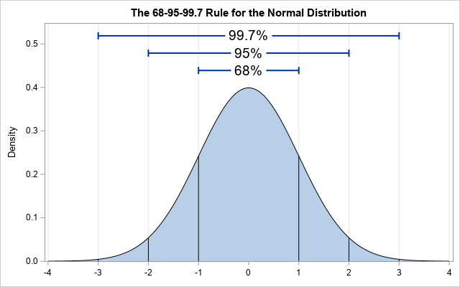
Assessment results are compared to a Normal Distribution (Bell Curve)

Slide 48
Understanding the Mean and Standard Deviation
The Mean is always at 50% so half the students score above the mean and half score below
The Standard Deviation is a measure of how spread out the numbers in the distribution are.
For many assessments, the Mean is set at 100 and the Standard Deviation is 15
For most assessment subscales, the Mean is set at 10 and the Standard Deviation is 3

Slide 49
Steps to Scoring an Assessment:
Harry completes the assessment
Harry’s Raw Scores is converted to a Standard Scores using an algorithm specifically developed and validated for that assessment
Harry’s Standard Scores are compared to the Normal Distribution of other student’s scores at that age or grade, and we can determine the Percentile
The Percentile means how many students in the comparison population scored lower than Harry, so if Harry’s score is in the 30th percentile, 30% of students scored lower, 70% scored higher
Average response from non-statisticians:

Slide 50
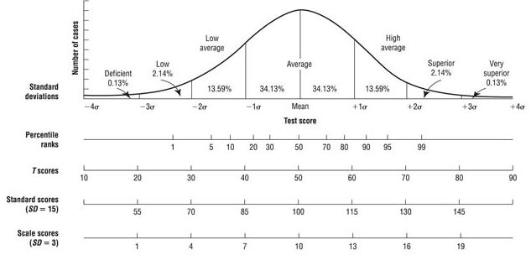
Comparing Scores to the Normal Distribution
Looking at Harry’s scores, assume his score on a test is 115. What percentage of students did Harry score better than?
What percentage scored higher than Harry?
84.3%
15.7%

Slide 51
Subtests
Subtests are typically standardized with Mean=10 and SD=3

Slide 52
Questions?

Slide 53
Conversion Tables Turn Standard Scores into Percentiles
Standard Score | Percentile | Subtest Scale Score | Description
150 | >99.9 |  | Very Superior
149 | >99.9 |  | Very Superior
148 | 99.9 |  | Very Superior
147 | 99.9 |  | Very Superior
146 | 99.9 |  | Very Superior
145 | 99.9 | 19 | Very Superior
144 | 99.8 |  | Very Superior
143 | 99.8 |  | Very Superior
142 | 99.7 |  | Very Superior
141 | 99.7 |  | Very Superior

Slide 54
Suggestions for Parents:
Request all evaluation reports two days in advance of the IEP Team meeting in writing
Read through the whole report, including the summary and recommendations
Go back and look at the actual scale results, and see if anything stands out as very different.
Write down all of your questions, including anything in the report that you don’t understand
If you disagree with anything in the evaluation, write down why

