Slide 1
Know Your Rights
Sarang Sekhavat
Federal Policy Director

Slide 2
Agencies and Laws
US Department of Homeland Security
US Citizenship and Immigration Services (USCIS)
US Immigration and Customs Enforcement (ICE)
US Customs and Border Protection (CBP)
US Department of Justice
Executive Office for Immigration Review (EOIR)
Board of Immigration Appeals (BIA)
Immigration and Nationality Act (INA)
8 Code of Federal Regulations (8 CFR)

Slide 3
Non-immigrants
Persons seeking entry into the U.S. for a limited period of time and for a specific purpose
22 nonimmigrant visa categories: A-V
B-2 visitors for pleasure
F-1 students
H-1B professional workers
H-2A short-term agricultural workers
H-2B temporary non-agricultural workers
J-1 exchange students or trainees
K-1 fiancé visa
Various humanitarian categories
TPS, DED, DACA

Slide 4
Older Employment Authorization Document

Slide 5
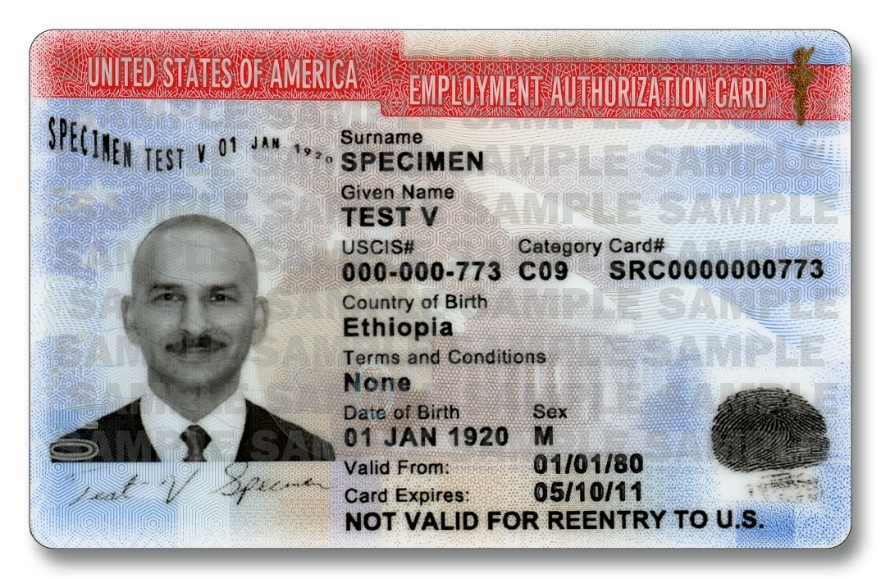
Most Recent EAD

Slide 6
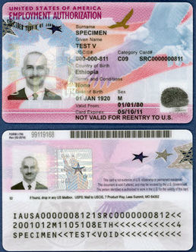
Current EAD

Slide 7
Immigrants
Lawful Permanent Residence (LPR) – the status of being lawfully accorded the privilege of permanently residing in the U.S. as an immigrant
May engage in almost all types of employment
After requisite period of residence – may apply for U.S. citizenship
Can be deported if subject to a ground of
deportation
May lose status if deemed abandoned

Slide 8
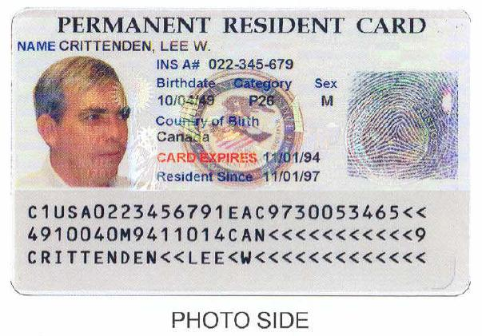
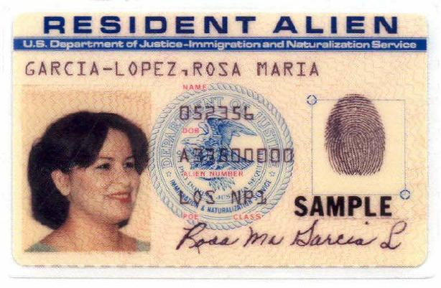
Older Greencards

Slide 9
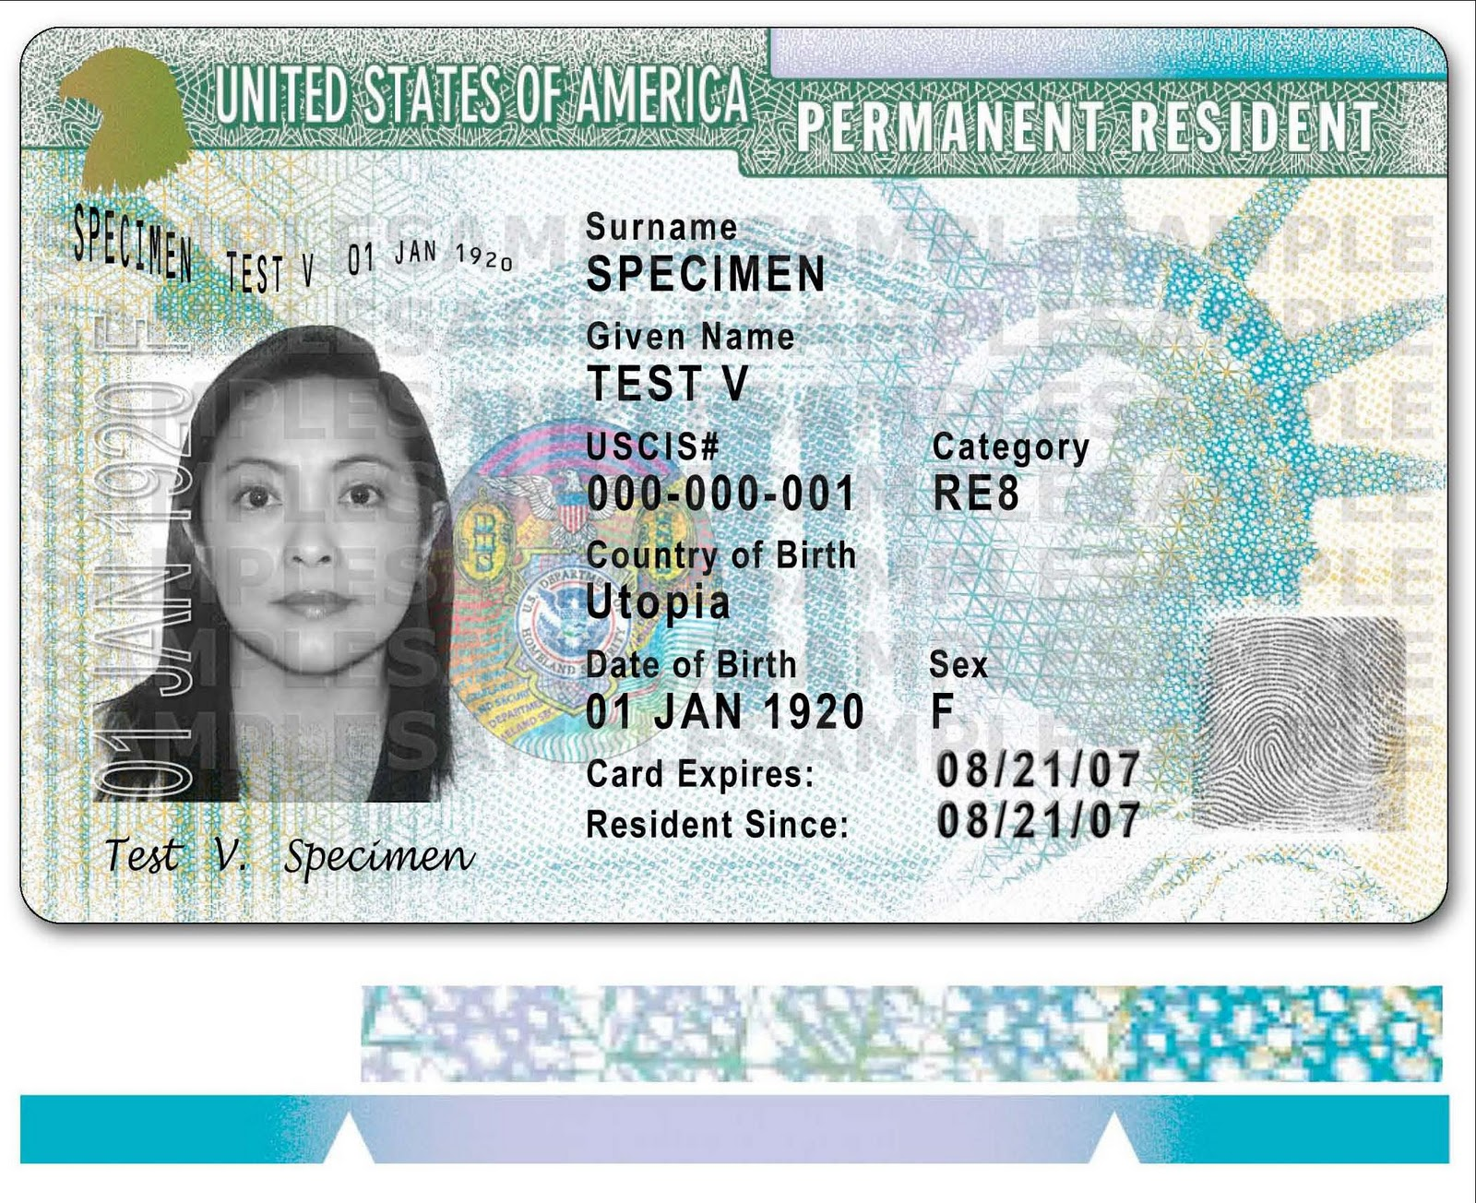
Most Recent Greencard

Slide 10
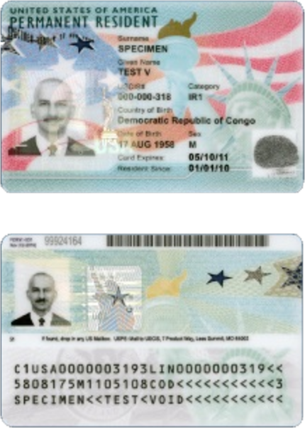
Current Greencard

Slide 11
Undocumented Immigrant
A person who is present in the US without the permission of the US government
Illegal entry without being inspected by an immigration officer (EWI), or by using false documents
Legal entry on a temporary visa and violating the terms of that visa, usually by remaining in the US
beyond the expiration date of the visa
(4 out of 10 enter legally)

Slide 12
OBTAINING A GREEN CARD

Slide 13
Some Paths to a Green Card
Family Sponsored
Employment Based
Special Immigrants (battered spouses and children, religious workers, juveniles)
Diversity Immigrants
Refugees and Asylees

Slide 14
Family-Based Process
First step: US citizen or LPR relative (petitioner) files petition for foreign family member (beneficiary)
Second step: Beneficiary applies to immigrate either in the U.S. through adjustment of status or at a U.S. consulate in home country through consular processing

Slide 15
Who can apply for whom?
US citizen may petition for: spouse, parents, children (any age, married or unmarried), siblings
LPR may petition for: spouse and children (any age, unmarried)
Divided into:
immediate relatives (no annual limit)
preference system (under annual quota)

Slide 16
Immediate Relative
Spouse of U.S. Citizen
Parent of U.S. Citizen
Unmarried Child under 21 of U.S. Citizen

Slide 17
Preference Categories
First: Unmarried Sons and Daughters of U.S. Citizens. 23,400 plus any numbers not required for fourth preference.

Slide 18
Preference Categories
Second: Spouses and Children, and Unmarried Sons and Daughters of Permanent Residents. 114,200, plus the number (if any) by which the worldwide family preference level exceeds 226,000, plus any unused first preference numbers
Spouses and Children of Permanent Residents. 77% of the overall second preference limitation, of which 75% are exempt from the per-country limit.
Unmarried Sons and Daughters (21 years of age or older) of Permanent Residents. 23% of the overall second
preference limitation.

Slide 19
Preference Categories
Third: Married Sons and Daughters of U.S. Citizens. 23,400, plus any numbers not required by first and second preferences.
Fourth: Brothers and Sisters of Adult U.S. Citizens. 65,000, plus any numbers
not required by first three preferences.

Slide 20
Family-sponsored Immigration
Category | All Except… | China | India | Mexico | Philippines
1st | 01/15/13 | 01/15/13 | 01/15/13 | 08/08/97 | 07/01/08
2A | Current | Current | Current | Current | Current
2B | 06/01/14 | 06/01/14 | 06/01/14 | 08/01/98 | 09/01/08
3rd | 09/15/07 | 09/15/07 | 09/15/07 | 02/22/96 | 04/01/98
4th | 11/22/06 | 11/22/06 | 10/01/04 | 12/15/97 | 07/08/98

Slide 21
Violence Against Women Act (VAWA)
Passed by Congress in 1994
Spouses and children of US citizens or lawful permanent residents (LPR) may self-petition to obtain lawful permanent residency
Certain battered immigrants may file for immigration relief without the abuser’s assistance or knowledge, in order to seek safety and independence from
the abuser

Slide 22
Who is eligible to self-petition?
Battered Spouse married to a US Citizen or LPR
Battered Child of an US Citizen or LPR
Non-abusive parent of a battered child of a US Citizen or LPR
Elder parent of a US Citizen over 21

Slide 23
Employer Sponsored Immigration
US employer can sponsor someone for a specific position where there is a demonstrated absence of US workers
Most employment based-aliens must obtain a Labor Certification (US Dept of Labor verifies that no American worker is available, qualified, and willing to take the job at the prevailing wage)

Slide 24
5 Different Categories
1st Preference: People of extraordinary ability in science, art, education, business, or athletics, and outstanding professors, researchers, and multinational executives and managers (40,000)
2nd Preference: Professionals with advance degrees or people of exceptional ability in science, arts, or business (40,000)

Slide 25
5 Categories (cont.)
3rd Preference: Skilled and unskilled workers, recently graduated professionals, and those with a bachelor’s degree (40,000)
4th Preference: Certain special immigrants, including ministers, religious workers, and others (10,000)

Slide 26
5 Categories (cont.)
5th Preference: People who have between $500,000 and $3 Million dollars to invest in a job-creating enterprise in the US. At least 10 US workers must be employed by each investor. The Amount of money can vary depending on which area of the country will benefit from the investment (10,000)

Slide 27
Employer Sponsored Immigration
Category | All Except… | China | India | Mexico | Philippines | Vietnam
1st | 04/22/18 | 11/01/16 | 01/01/15 | 04/22/18 | 04/22/18 | 04/22/18
2nd | Current | 01/01/15 | 05/12/09 | Current | Current | Current
3rd | Current | 11/01/15 | 01/01/09 | Current | 10/15/17 | Current
4th | Current | Current | Current | 05/01/17 | Current | Current
5th | Current | 10/22/14 | 11/22/17 | Current | Current | 10/15/16

Slide 28
Diversity Immigrant
Permits additional opportunities for persons from countries with low admissions during the previous five years.
55,000/year divided into 6 geographic regions:
Africa
Europe
North America
Oceania
South America and the Caribbean

Slide 29
What is a Refugee/Asylee?
Person outside of the US who seeks protection on the grounds that he or she fears persecution in his or her homeland
To attain refugee status, proof of “well-founded fear of persecution on the basis of five internationally recognized grounds:
Race
Religion
Membership in a particular social group
Political opinion
National origin

Slide 30
Withholding of Removal or Deportation:
Individuals must meet higher substantive standard than for asylum
Life or freedom would be threatened
Unlike asylum because it is non-discretionary
No basis to apply for LPR status
May receive employment authorization

Slide 31
What is a U Visa?
The U Visa was created by the Victims of Trafficking and Violence prevention Act, enacted in October 2000. It is available to non-citizens who:
Have suffered substantial physical or mental abuse resulting from qualifying criminal activity,
Have information concerning that criminal activity,
Have been helpful, are being helpful, or are likely to be helpful with the investigation or prosecution of the crime, and
The criminal activity must have violated the laws of the United States or occurred in the U.S.
The U Visa provides eligible immigrants with authorized stay in the US and employment authorization. They can eventually become
eligible for lawful permanent residency and citizenship.

Slide 32
U Visa – Qualifying Crimes
Abduction
Abusive Sexual Contact
Blackmail
Domestic Violence
Extortion
False Imprisonment
Female Genital Mutilation
Felonious Assault
Fraud in Foreign Labor Contracting
Hostage
Incest
Involuntary Servitude
Kidnapping
Manslaughter
Murder
Obstruction of Justice
Peonage
Perjury
Prostitution
Rape
Sexual Assault
Sexual Exploitation
Slave Trade
Stalking
Torture
Trafficking
Witness Tampering
Unlawful Criminal Restraint
Other Related Crimes

Slide 33
Victims of Human Trafficking
At least 50,000 women and children and an undetermined number of men are trafficked into the US every year
Congress allotted 5,000 “T” visas for victims of these crimes (can apply for green card after 3 years)
To be eligible for benefits:
Must be certified by ORR
Must have filed a ‘bona fide” application for a “T’ visa that has not been denied, or presence necessary for prosecution of traffickers
Benefits agencies must accept ORR certification letter in place of CIS documentation
Technically not “qualified,” but eligible for all federal benefits, and all state benefits administered by federal agency or funded with
federal funds to the same extent as refugees
Also eligible for refugee programs

Slide 34
Requirements for a T-visa
A T-visa is a non-immigrant category for victims of trafficking for illicit sexual purposes and slavery
Be physically present in the US, American Samoa, the Commonwealth of the Northern Mariana Islands, or a US port of entry because of such trafficking
Have complied with any reasonable request for assistance to law enforcement in the investigation or prosecution of acts of trafficking, or be under the age of 15; and
Be likely to suffer extreme hardship involving unusual and severe harm upon removal
The Attorney General may, in order to avoid extreme hardship, permit the spouse, children and parents of an alien under 21, and the spouse and children of an alien over 21
to accompany or follow to join the principal alien.

Slide 35
Special Immigrant Juvenile
Requires finding of abuse, abandonment, or neglect in state court
Eligible for LPR status up to age 21
MA state courts only had jurisdiction up to age 18
SJC decision in Rivera Recinos, Probate and Family Court has jurisdiction under equity power
USCIS rejected cases without statutory jurisdiction
FY 2019 state budget extended jurisdiction
Visas backlog: July 1, 2016 for El Salvador, Guatemala, and Honduras

Slide 36
Public Charge Blocked

Slide 37
Admissibility
“Removable”
“Inadmissible”
“Deportable”

Slide 38
What is “Public Charge”
Refers to a person who is likely to become dependent on the government for financial or material support
Can be the basis for denying “admission”
Non-immigrant visa
Green Card

Slide 39
Who is Subject?
Anyone seeking LPR status through a family petition
Certain individuals seeking LPR status through an employment petition
Individuals seeking a non-immigrant
visa

Slide 40
Who is NOT Subject?
Refugees/aslyees
VAWA self-petitioners
U visa beneficiaries
Individuals renewing TPS or DACA
Special Immigrant Juveniles
Applicants for naturalization
Individuals renewing a green card

Slide 41
Current Policy
An individual who is likely to become primarily dependent on the government for subsistence, as demonstrated by either the receipt of:
(1) Public cash assistance for income maintenance: TANF, SSI, or similar state and local programs
(2) Institutionalization for long-term care at
government expense

Slide 42
Factors They Consider
Age
Health
Family Status
Assets
Resources
Financial Status
Education
Skills
No single factor will be determinative

Slide 43
Factors to Consider
Not Subject to Public Charge Consideration
Medicaid
CHIP
SNAP
WIC
Housing
Child Care Services
Energy Assistance

Slide 44
Current Policy
I-864, Affidavit of Support
Filed by sponsor of intending immigrant showing household income ≥ 125% of the federal poverty limit
Properly filed I-864 is usually sufficient
to find that a person will not be a
public charge

Slide 45
Court Injunctions
Nationwide:
Washington
New York
Maryland
State Specific:
California (CA, OR, ME, PA, DC)
Illinois (IL only)

Slide 46
New Rule
Implementation Delayed Indefinitely
New Definition for “Public Charge”
An individual who is, “likely at any time in the future to receive one or more,” of the listed public benefits

Slide 47
Subject to Public Charge Consideration
Where any of the benefits are received for an aggregate 12 months during a 36 month period.
Cash assistance programs (TANF, SSI)
Any benefit for long term institutional care
Supplemental Nutritional Assistance Program (SNAP)
Section 8 Housing
Non-Emergency Medicaid
(except children and pregnant women)

Slide 48
Factors to Consider
Age – Not working age?
Health – Chronic illness?
Family Status
Assets
Resources
Financial Status
Education – LEP?
Skills

Slide 49
New Factors to Consider
Authorized to work but not employed or a full-time student
Received or been approved to receive listed benefit
Lacking private health insurance

Slide 50
Proposed Policy
Affidavit of Support
I-864 loses weight
Family support won’t be heavily weighted under 250% FPL

Slide 51
Resources
Protectingimmigrantfamilies.org
Miracoalition.org/pif

Slide 52
What Can We Do?
Education – make sure our communities know what the rule says and who it applies to
Story Collection – we need stories to share with the media (can be anonymous, but names would be better). Email stories to pifma@miracoalition.org.

Slide 53
Public Charge: Deportability

Slide 54
Current Law
Received benefits for reasons that existed prior to admission;
Received such benefits within 5 years of admission;
You or sponsor owe a debt to the government to reimburse for benefits and received notice to reimburse within 5 years of admission; and
You or sponsor failed to repay and the
government won a suit to
demand repayment.

Slide 55
What do we know?
Expected – placeholder language in draft USCIS Public Charge that leaked to the press
Some things they can’t change
Will come from DOJ (Immigration Courts), not USCIS
No solid indications of timing, but could be soon
Same process as Admissibility change

Slide 56
Proposed HUD Rule

Slide 57
HUD Proposed Rule
All residents under 62 years old must have status verified through SAVE
Head of household or spouse must have authorized, eligible status

Slide 58
HUD Proposed Rule
25,000 households
108,000 people
70% (76,000) legally eligible
55,000 children legally eligible
$8,400/year for mixed status families

Slide 59
Temporary Protected Status

Slide 60
Temporary Protected Status
Granted to nationals of countries in crisis who are presently in the U.S.
–On-going armed conflict
–Natural disaster
–Extraordinary temporary conditions
May last for 6, 12 or 18 months
Cannot apply for TPS from home country

Slide 61
Temporary Protected Status
Country | National #s | Designated | Expires
El Salvador | 262,500 | 2001 | January 2, 2020
Haiti | 58,600 | 2010 | January 2, 2020
Honduras | 86,000 | 1999 | January 5, 2020
Nepal | 14,800 | 2014 | January 2, 2020
Nicaragua | 5,300 | 1999 | January 2, 2020
Somalia | 500 | 2001 | March 17, 2020
Sudan | 1,050 | 2004 | January 2, 2020
South Sudan | 75 | 2011 | November 2, 2020
Syria | 6,900 | 2012 | March 31, 2021
Yemen | 1,250 | 2015 | March 3, 2020

Slide 62
DACA

Slide 63
DACA - Eligibility
Entry before June 15, 2007
Entry before turning 16 years old
Born after June 15, 1981
Undocumented on June 15, 2012
Be in school or have graduated from high school
Have no felony convictions, no more than 2 misdemeanor convictions, and no convictions for a “significant misdemeanor”

Slide 64
DACA – Where are we?
September 5, 2017: announcement ending DACA
Various courts issued injunctions keeping DACA open:
January 9, 2018: CA District Court.
November 8, 2018: 9th Circuit affirmed District Court opinion
February 13, 2018: NY District Court
March 5, 2018: MD District Court DENIED injunction
May 17, 2019: 4th Circuit reversed District Court opinion
April 24, 208: DC District Court
Supreme Court hearing November 12!

Slide 65
Other Issues

Slide 66
Census
Supreme Court blocked inclusion of citizenship question
Encourage everyone to fill out the census
Law protects against use of census information for law enforcement purposes

Slide 67
Fee Waiver
Mostly used for citizenship and green card renewals
Eligibility:
Means-Tested Benefit
≤ 150% FPL
Financial Hardship
Can use old form until Dec 2, 2019.

Slide 68
Notice To Appear
Charging document for immigration court
Under Obama, USCIS would only issue if:
Serious criminal conduct
Fraud in the application
New policy to issue NTA anytime an applicant is removable

Slide 69
Matter of A-B
Particular Social Group
Impacted
Domestic Violence
Gang Violence
Grace v Whitaker – DC District Court enjoined policy in credible fear determinations

Slide 70
Enforcement Under Trump

Slide 71
The Current Landscape
No matter who is president, everyone living in the U.S. has certain basic rights under the U.S. Constitution.
Immigrants with status, pending status, and undocumented immigrants have Constitutional rights.
It is important to assert these rights
and protect our basic rights.

Slide 72
Trump Enforcement Priorities
Convicted of any criminal offense
Charged with any criminal offense
Committed an act that constitutes a criminal offense
Engaged in fraud or willful misrepresentation
Abused a public benefits program
Subject to a deportation order
Risk to public safety or national security
Eliminates categories for Prosecutorial Discretion!

Slide 73
Local Law Enforcement
Calls for expanding use of 287(g) agreements
Calls for expanding use of Criminal Alien Program (CAP)
Brings back “Secure Communities”

Slide 74
Due Process
Drastic expansion of the use of expedited removal
Previously: within 2 weeks of entry and caught within 100 miles of the border.
Makes it harder for new entrants to pass a “Credible Fear Interview”

Slide 75
Unaccompanied Minors
Redefine “Unaccompanied Minors” to remove protections from many children entering the country alone
Takes away the right to an affirmative asylum claim;
Takes away right to be placed with family rather than detained;
Makes them subject to expedited removal.
Criminalize parents who help their children
escape extreme violence

Slide 76
Travel Ban
Country | Banned
North Korea Syria | All
Iran | Immigrant Non-Immigrant – Except F, M, J
Chad Libya Yemen | Immigrant B1/B2 Non-Immigrant
Somalia | Immigrant
Venezuela | B1/B2 Non-Immigrant for government officials and their families

Slide 77
Travel Ban – Exceptions
LPRs
Admitted or paroled
Diplomats
Already granted asylum

Slide 78
Travel Ban – Waivers
Previously admitted for continuous work, study, or other reason
Previously established significant contacts
Significant business or professional obligations
Close family member (spouse, child, or parent) and undue hardship
Infant, adoptee, or medical necessity
Employed by on behalf of the US
Canadian permanent resident applying in Canada
International organization
US-sponsored exchange visitor
Traveling at the request of the US

Slide 79
What To Do When Confronted By Law Enforcement

Slide 80
What are My Rights if Law Enforcement Confronts Me
Regardless of whether you have status or not, you have basic rights under the U.S. Constitution, no matter who is President of the United States.
Be familiar with these rights and be comfortable asserting them so that your rights can be protected.

Slide 81
What if Law Enforcement Comes to my Home?
You do not need to open the door unless the officer provides you with a court warrant.
Do not open the door.
Slide your “Know Your Rights” card under the door.
Ask to see a signed warrant from a judge.
Look at the warrant carefully to make sure it is signed by a judge.
Call an attorney.

Slide 82
Judicial Warrant - Signed by a Judge

Slide 83
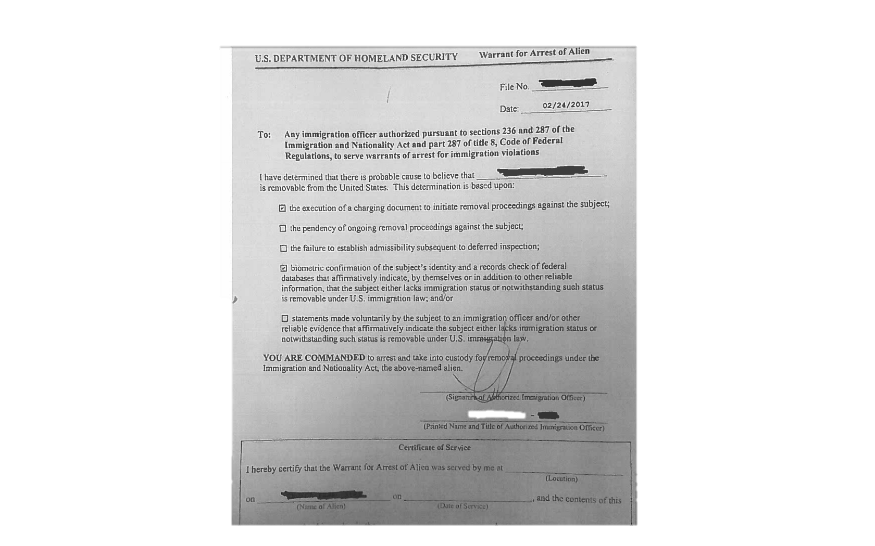
Arrest Warrant- Not Signed by a Judge

Slide 84
What if Law Enforcement Comes to my Home?
You do not have to let ICE or other law enforcement into your home without a signed warrant from a judge.
If you allow ICE into your home, they can look for your passport as evidence that you are not a U.S. citizen.
If ICE officers find evidence in your home, they can use the evidence against you.

Slide 85
What if Law Enforcement Confronts me in Public?
Stay calm. Do not run or resist arrest.
Keep your hands where they officer can see them. Do not get upset or agitated.
Ask if you are under arrest or free to leave. If you are free to leave, ask to leave.
You have the right to remain silent. Say you want to remain silent.
You have a right to an attorney.

Slide 86
You have the Right to Remain Silent!
You DO NOT have to answer questions, even simple ones about where you are from.
Say you want to remain silent.
Ask to call a lawyer.

Slide 87
Can I be Deported?
The only people who cannot ever be deported are U.S. citizens.
People with immigration status can lose that status if they commit certain crimes or violate their status.
ICE needs information about where you were born and where you are a citizen in order to place you into immigration court.

Slide 88
How can I be Prepared?
Know your rights in case an officer asks you questions or comes to your home.
Memorize phone numbers for your family members and/or an attorney/organization that you trust. You might only be able to make one phone call while detained!
Think of a U.S. citizen or someone with immigration status that you trust who can pay bond if you are granted one by an immigration judge.

Slide 89
How can I be Prepared?
Make sure all information and emergency contacts are up to date at your children’s school(s), including who can and cannot pick up your children.
Create a sheet of emergency numbers and contact information and a file of important documents so that you, your family or your emergency contact person can easily access them.
Complete a caregiver’s authorization affidavit so another adult can care for your children.
Designate and document someone you trust with Power of Attorney to make financial, legal or childcare decisions in your absence.

Slide 90
What About My Children?
Having a U.S. citizen child will not protect you from deportation.
ICE does detain entire families together in special detention facilities.
Undocumented children have a right to public education. The school should not be asking about immigration status.
If the school asks for a social security number when registering your child, leave the information blank. Do not provide a fake number.

Slide 91
What Happens if I am Detained?

Slide 92
What Immigration Status do I Have?
It is important to understand whether you have immigration status or not.
Have you ever filed an application with immigration before?
Do you have a work card or a green card?
Have you ever been caught by immigration before? At the border?
Do you have an open court case?
Did you ever miss a court hearing?
Did you miss a scheduled interview?
Have you ever had any contact with immigration?

Slide 93
Do I Have the Right to See an Immigration Judge?
If you have never seen an immigration judge before or have never been ordered deported at the border before, you probably have a right to see an immigration judge.
In immigration court, you have the right to have an attorney represent you, but the attorney is not free.
Ask for the legal services list of attorneys.
You have a right to apply for any forms of
immigration relief that you qualify for.

Slide 94
Do I Have the Right to See an Immigration Judge?
If you have already been ordered deported by an immigration judge or at the border, you will not automatically be able to see a judge.
You should speak with an experienced immigration attorney to get advice on your case.

Slide 95
Can I Ask for Bond if I am Detained?
Not everyone is eligible for a bond.
If you are granted bond, you cannot miss a court appointment or you will be ordered deported.
Things that an immigration judge will look at in determining whether to grant a bond:
Family/community ties
Danger to the community
Bond is difficult, get assistance from an experienced attorney.
Start thinking of who you would ask to write letters
supporting your request for bond.

Slide 96
Immigration Released Me – Now What?
Wait for a court date
In western MA, people could have court in either Boston, MA or Hartford, CT.
Some might have court dates in Texas or elsewhere, you can request to have the location of your case changed.
Call 1-800-898-7180 to check court date and location.
If you move, comply with requirements for the court and DHS.
Do NOT miss a court date. Missing a court date usually results in a deportation order.

Slide 97
Immigration Released Me – Now What?
Reporting
Some people released by immigration will be required to report to ICE in person.
Those with a bracelet might have regular check-ins at their home.
Someone with reporting requirements or a bracelet should speak to a lawyer as soon as possible.
Anyone in immigration proceedings should consult
with an attorney as soon as possible.

Slide 98
Other Rights

Slide 99
Education Rights
All students have a right to education free from unlawful discrimination and harassment, regardless of immigration status.
Federal law prohibits schools from disclosing a student’s personally identifiable information without written consent.
Exception for “directory information” (opt out).
Generally, schools should not collect or maintain information relating to the immigration
status of students or parents.

Slide 100
Access to Healthcare
Protected Health Information is protected by federal and state law.
Emergency departments must provide screening and stabilization services regardless of an ability to pay or immigration status.
AGO recommends that healthcare providers collect only as much information on immigration status as is necessary to for treatment or regulatory
compliance purposes.

Slide 101
Employment Rights
All workers, regardless of immigration status, are protected by labor and employment laws.
Rights:
To be paid a legal rate of pay, including minimum wage and overtime.
Free from sexual harassment and other forms of discrimination in the workplace.
Safe and healthy workplace.
AGO will not tolerate retaliation against
a worker asserting their legal rights.

Slide 102
Where Can People Get Help?

Slide 103
What Resources Are Available?
Mayor’s Office for Immigrant Advancement
Free consultations every first and third Wednesdays,
noon – 2pm
1 City Hall Square, Room 806
Boston, MA 02201
Irish International Immigrant Center
(617) 542-7654
www.iiicenter.org
Please understand that there are not sufficient non-profit services available and you may need to pay for representation.

Slide 104
What Resources Are Available?
Catholic Charities
(617) 464-8100
PAIR Project
Helps with bond, detained immigration cases, and asylum
(617) 742-9296

Slide 105
What Resources Are Available?
Kids In Need of Defense (KIND)
SIJS and other relief for children
(617) 207-4138
Committee for Public Counsel Services
Call for information to see if you qualify for free services for your criminal case (pending or post-conviction relief)
If you have a criminal case, do not submit anything to immigration unless you have spoken to an experienced attorney.
(617) 207-4138

Slide 106
What Resources Are Available?
Office of the Attorney General
To report the unauthorized practice of immigration law/immigration fraud)
Civil Rights Division
One Ashburton Place
Boston, MA 02108
(617) 963-2917
To report a hate crime: Any Massachusetts resident who has witnessed or experienced bias-motivated threats, harassment or violence may call the Attorney General’s Hotline
at (800) 994-3228.

Slide 107
Sarang Sekhavat
Federal Policy Director
ssekhavat@miracoalition.org
@MIRACoalition

