Slide 1
Marisol Garcia, Senior Director
Mental Health Advocacy Program for Kids
Date 2.24.2021

Slide 2

Health Law Advocates’ Mental Health Advocacy Program for Kids
MHAP for Kids improves the health and increases the educational success of children with unmet mental health needs. Experienced staff attorneys provide free legal representation to low-income families, advocating for access to mental health services and diverting children from the juvenile justice and child welfare systems.

Slide 3
MHAP for Kids – statewide advocacy program
MHAP for Kids’ attorneys are based out of 10 DCF Family Resource Centers and provide free legal services to families statewide. MHAP for Kids’ attorneys collaborate with FRC staff to achieve their mission of diverting children from the court system to health and social services, furthering the objectives of CRA reform, Chapter 240 of the Acts of 2012.

Slide 4
Attending special education team meetings to advocate for eligibility for services or improved services,
Seeking eligibility and services from state agencies, like DMH and DDS,
Advocating for diversion from the juvenile justice and child welfare systems, and
Ensuring that families have access to health insurance.
MHAP for Kids attorneys serve hundred of families

Slide 5
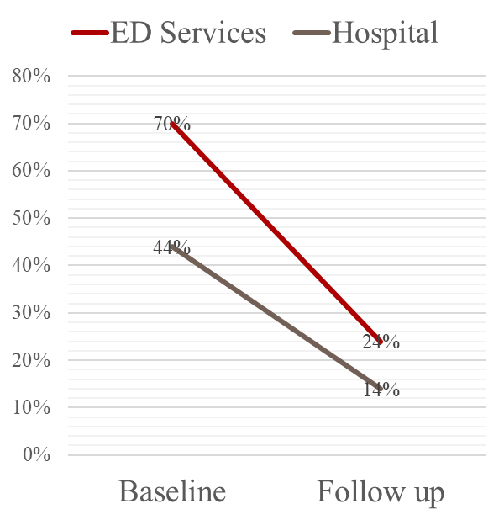
The Boston University School of Public Health Evaluation 2017
MHAP for Kids has a proven track record of significantly improving the lives of high-risk youth and their families in a cost-effective manner.
An independent study found that the program substantially improves children’s mental health while
Dramatically improving school attendance (daily truancy: 26% reduced to 9%).
Significantly decreasing use of emergency mental health services by children (70% reduced to 24%)
Dramatically decreasing inpatient hospitalizations of children (44% reduced to 14%).
Significantly improves overall mental health of children
Significantly improves overall mental health of caregivers
Significantly decreases rates of family conflict
MHAP for Kids continues to collect data and BUSPH continues to analyze the data to evaluate the impact of the legal work on children and families.

Slide 6
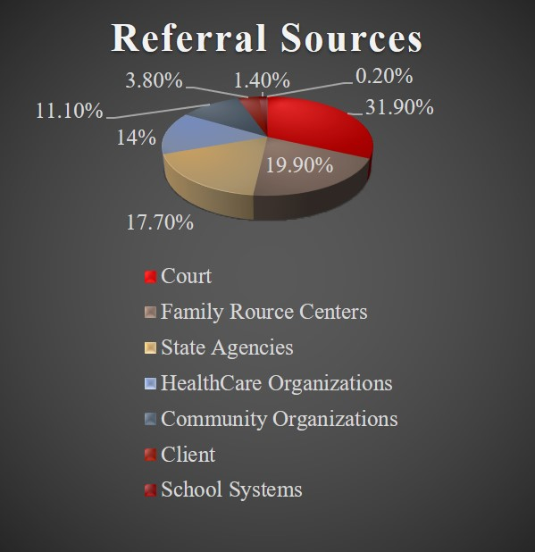
MHAP for Kids’ statewide intake line 617-275-2919
MHAP for Kids receives referrals from all types of community stakeholders.
All families are income eligible: 300% FPL.
All children have mental health access needs.

Slide 7

MHAP for Kids’ statewide intake line 617-275-2919
Since the MHAP for Kids Staff Attorneys are a limited resource, we prioritize cases when:
A child is “stuck” in either the hospital or juvenile detention;
A child is at risk of needing a higher level of care unless appropriate community-based programs are put in place;
A child is at risk of being suspended and/or expelled from school; or
A child is at risk of entering the juvenile justice system.

Slide 8
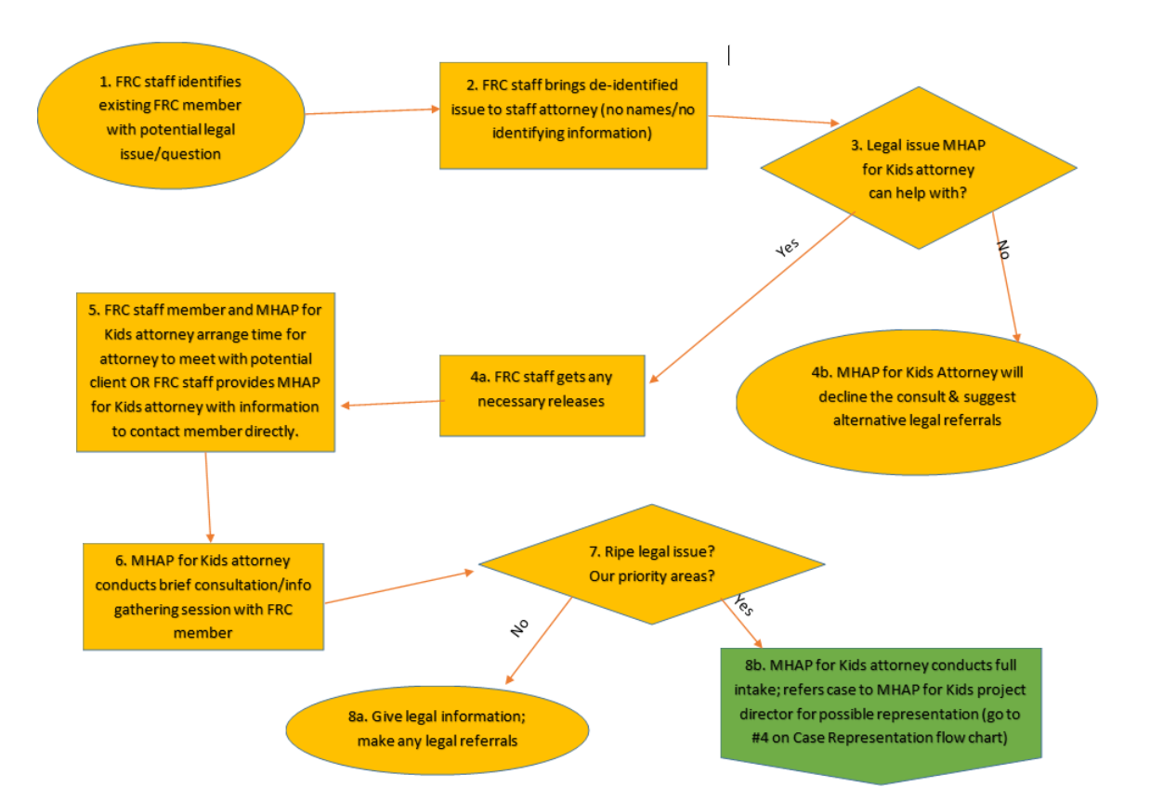
How FRC staff and MHAP for Kids attorneys work together

Slide 9

MHAP for Kids’ statewide intake line 617-275-2919
1. Parent / Guardian calls our intake line 617-275-2919.
2. Intake is completed by MHAP for Kids’ paralegal. The paralegal collects information about a child’s educational, mental health, and juvenile court history. The intake takes about 15-20 minutes. A language line is available for translation services.
3. Within 24 hours, intake reviewed by Director.
4. If approved by Director, a letter is sent to the family and the paralegal reaches out to the parent/guardian for data collection: baseline interview and questionnaire.
5. When baseline interview and questionnaire are complete, the intake is sent to attorney and the investigation process begins.
6. If not approved by Director, letter is immediately sent to the family and other resources are identified.

Slide 10

MHAP for Kids’ Investigation Process for New Intakes
Within 1 day, staff attorney reviews the intake form.
2. Within 2 days, staff attorney calls the parent/guardian to set up appointment.
3. Within 2 weeks, attorney meets with the family, obtains appropriate releases, requests relevant records, and reaches out to providers.
4. Attorney and guardian will set goals for legal advocacy.
5. Supervisor and Attorney meet weekly to discuss cases.

Slide 11
Case Success Video
Tristan’s Story
https://vimeo.com/302718751

Slide 12

MHAP for Kids Advocacy During COVID-19
MHAP for Kids attorneys participate in court proceedings, hearings, client meetings, settlement conferences, special education meetings, and other advocacy through video and audio conferencing.

Slide 13

MHAP for Kids Advocacy During COVID-19
A profile of the children MHAP for Kids has served since Governor Baker declared a state of emergency:
66% live in a city/town in the top 30 for highest COVID-19 rates
66% identify as a person of color
97% identified with mental health diagnosis at the time of MHAP for Kids intake
Average household income = 114% of the FPL ($29,000 for a family of four)

Slide 14

Further Questions?
MHAP for Kids Statewide Intake Line 617-275-2919
Marisol Garcia, Director
mgarcia@hla-inc.org
www.healthlawadvocates.org

