Slide 1
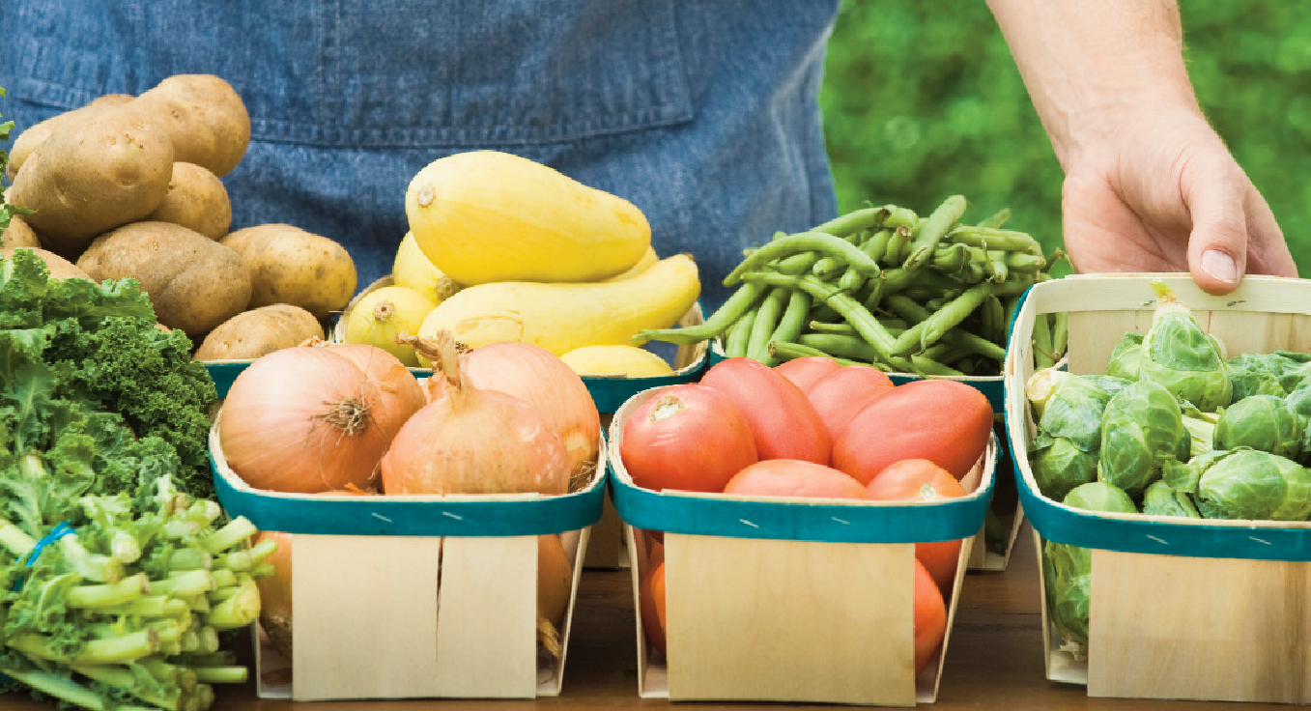
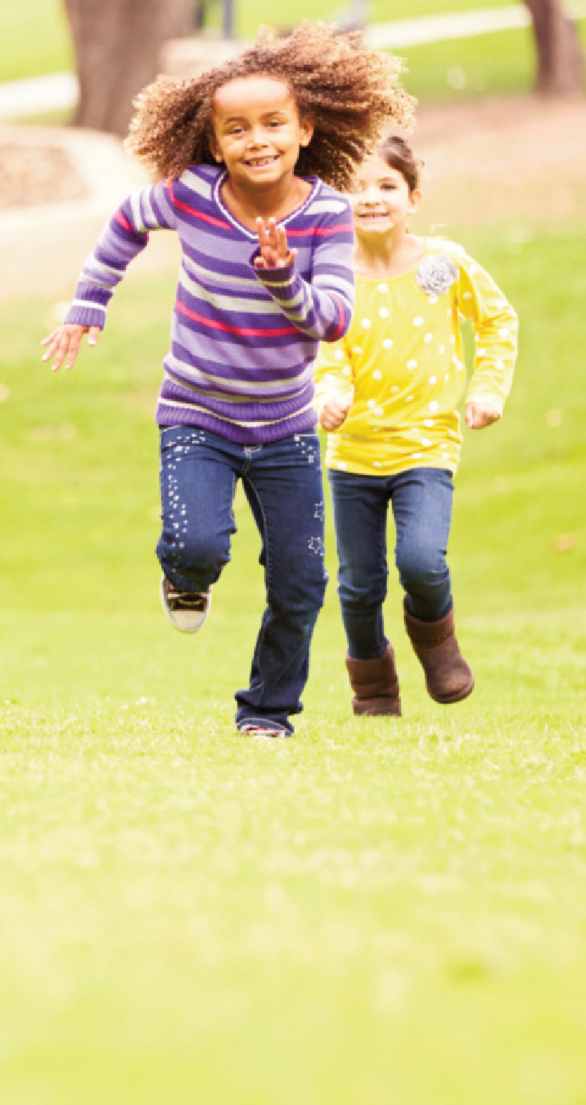
Expanded Food & Nutrition Education Program (EFNEP) Makes a Difference!
Notes:
This presentation could be used in three ways: inserted into a notebook in plastic sleeves, as a PowerPoint (broadcast on a laptop or on a screen), and as part of an information piece/visual aid placed in a folder along with a business card and impact sheet. This is Page One of the Marketing portfolio. Please consider the following:
Modify by using the Note pages to define audience, agencies.
Use by front-line manager and director to access new partner agencies and agencies needing enhanced collaboration
Make sure all titles and tag lines are consistent with all the marketing materials

Slide 2
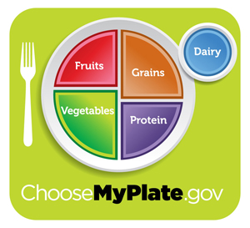
EFNEP’s Mission
Improve the health of low-income families and youth. EFNEP provides practical lessons on basic nutrition and healthy lifestyles, food resource management, and food safety.
Notes:
-Participating in these lessons contributes to participants’ personal development and the improvement of the total family diet and nutritional well-being.

Slide 3
Massachusetts Program Delivery
EFNEP trained nutrition educators from UMass Extension provide:
A series of 6-9 interactive nutrition lessons
Lessons tailored to a group of diverse individuals (adult or youth)
A healthy food demonstration and physical activity during most lessons
Materials available in English or Spanish
Promotion of engagement with community partners to make the clients’ families healthier.
Notes:
-Upon completion of the program, participants will receive a cookbook and certificate of graduation after attending at least 6 lessons.
-All classes and materials are FREE.

Slide 4
Topics for nutrition lessons are chosen to meet the needs of the group
For adult groups, examples include:
Using strategies to make the most of food dollars
Becoming more physically active
Eating more fruits, vegetables, and whole grains
Choosing foods that are lower in saturated fat, added sugar, and sodium
Keeping your food safe
Helping your child to eat healthier
Nurturing a healthy lifestyle for yourself
Notes:
-The Choices…Steps Towards Health curriculum is used with adults. It is a practice-based curriculum and includes a variety of lessons that welcome participants to the program and focuses on improving diet quality, physical activity, food resource management, food safety and food security.

Slide 5
Topics for nutrition lessons for youth:
Choosing healthy foods from MyPlate
Being physically active
Eating more fruits and vegetables
Eating a healthy breakfast
Drinking less soda and sweetened
beverages
Reading food labels
Improving food safety
Notes:
-UMass NEP uses the University of Missouri Extension’s Show Me Nutrition curriculum for youth (Pre-K to 8th grade). It is an evidence-based approach and includes activities to engage students in the classroom. Show Me Nutrition reinforces behaviors that support a healthy weight for children such as the examples above.

Slide 6
How Do Participants Benefit?
EFNEP nutrition educators empower participants to make healthy changes in their lives.
Participants learn how to save money when grocery shopping, use nutrition information to make healthier choices and cook delicious, affordable and healthy meals.
Participants learn how to incorporate physical activity into their daily lives.

Slide 7
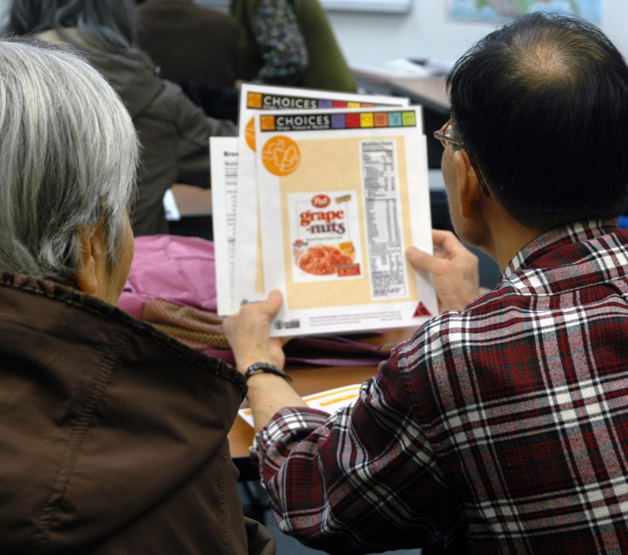
Classes are interactive and a hands-on learning experience for participants.

Slide 8
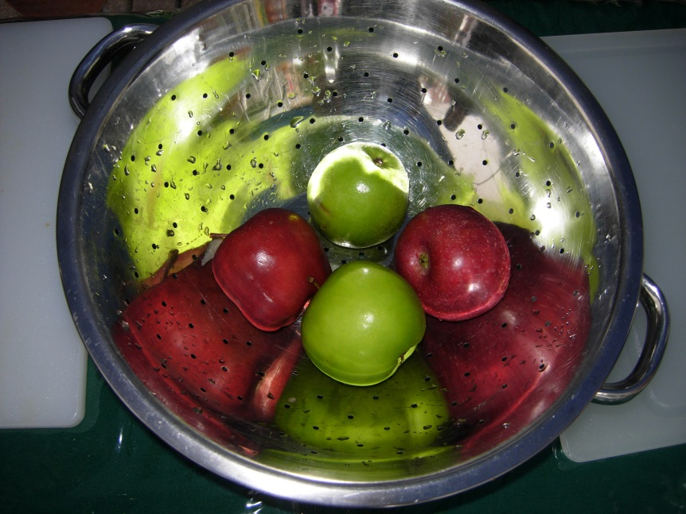
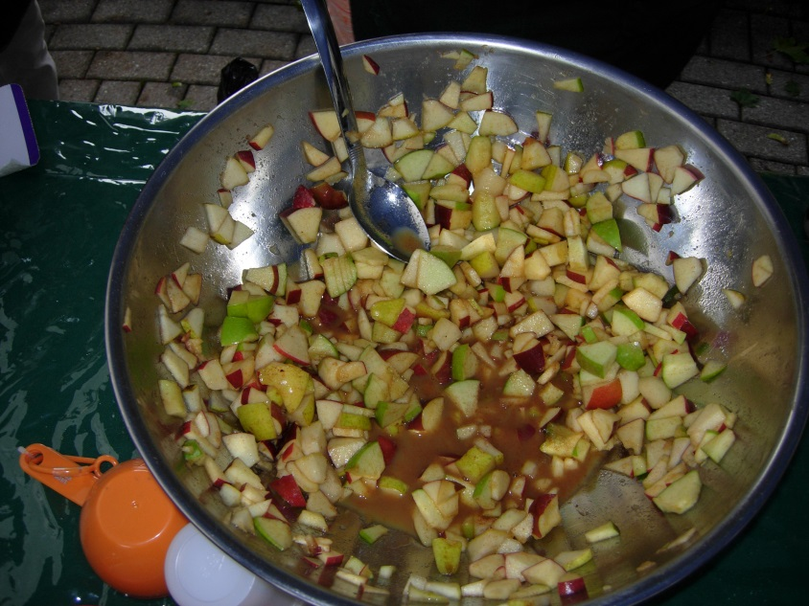
Tasting healthy recipes is part of most sessions.
Spicy Fruit Salad
https://www.youtube.com/watch?v=_x9_E0ZTYt8
Notes:
-Participants taste a variety of new foods and receive recipes to take home.

Slide 9
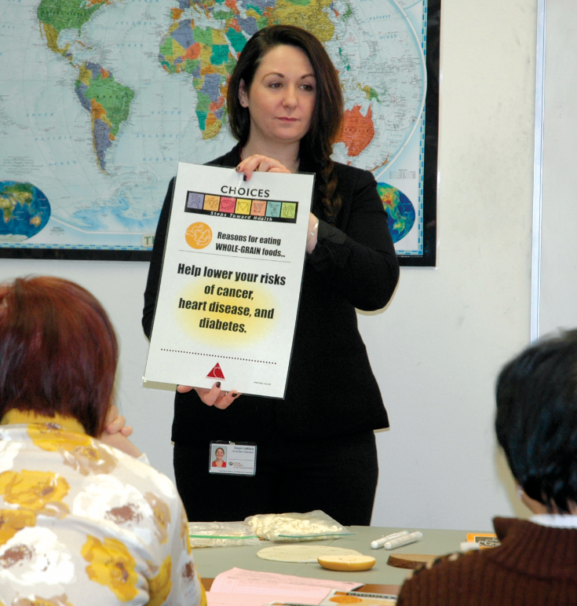
Classes and materials are available in English and Spanish

Slide 10
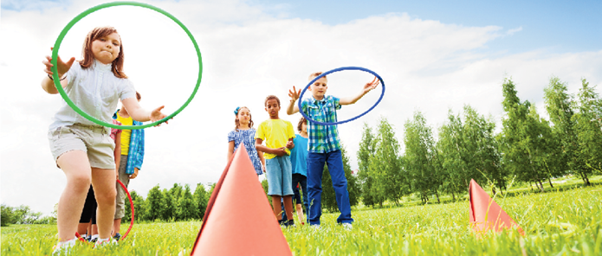
FY20 Youth Program Impacts
73% improved
diet quality
34% improved physical activity
54% improved
food safety
Notes:
I think this should have a success story—or there should be one to tell along with it.
Lined up bullet points; moved some things around

Slide 11
FY20 Adult Program Impacts
93% improved nutrition practices
78% improved in food resources management practices
77% improved food safety practices
77% improved in one or more physical activity behaviors
48% ate more fruits
47% ate more vegetables
Notes:
I think this should have a success story—or there should be one to tell along with it.
Lined up bullet points; moved some things around

Slide 12
Office Locations
CENTRAL MA
Rosalia Flores
rflores@umext.umass.edu
NORTHEAST MA
Jeanne Baranek
baranek@umext.umass.edu
WESTERN MA
Dalila Gomes
dfgomes@umext.umass.edu
EAST & SOUTHEAST MA
Lindsey Magan
lmagan@umext.umass.edu
We’d love to partner with you!

