Slide 1
Family Resource Centers
Adult Adolescent Parenting Inventory (AAPI) Data Entry Revised June 2026

Slide 2
Role of the Administrator
Provided credentials for accessing Assessing Parenting website
  Administrator shares credentials with staff person(s) who will enter the data
Responsible for Quality Control
  Ensure each class is entered with the correct naming convention
  Review entered data to ensure no personally identifiable information (PII) is entered and that the Family Member ID is entered correctly
  Check that date of birth (DOB) field is reflecting the month and day of the 1st assessment, and the participant’s actual birth year
Will be notified if PII is being entered or if class naming convention is incorrect
  We will send an initial email to the administrator. Site will have 7 business days to correct the data. If it is not corrected within 7 days, we will send a follow-up email and copy the community support specialist (CSS) to notify them we will delete the information to protect the Family Member’s identity.
Assessing Parenting Website for AAPI Data Entry:
www.https://assessingparenting.com/login

Slide 3
AAPI Data Entry – Class Naming Convention
The AAPI is used for the following programs:
  Nurturing Parenting®, Parenting Journey (all types), and Active Parenting Classes
Naming convention for the program (classes)
  Each Evidence-based (EVB) Parenting series that runs should be entered as its own program. Below are examples of how the classes should be listed in the Assessing Parenting database.
    Ex: Nurturing Fathers In-Person Feb – Mar 2022
    Ex: Parenting Journey 1 Hybrid Sept 15 2022 – Nov 30 2022
Do not name the program as your FRC. Each class should be identified separately as described above.
  The evaluation team checks the Assessing Parenting data with the CRM. They check CRM data on EVB Parenting classes and look at the class, if the AAPI indicators are entered, and if the Family Member graduated.
Class Naming Convention
Class name, listing specific evidence-based program
Type: In-person, virtual, hybrid
Timeframe: month & year

Slide 4
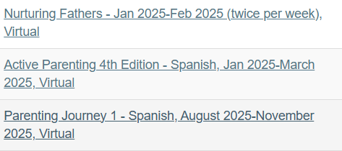
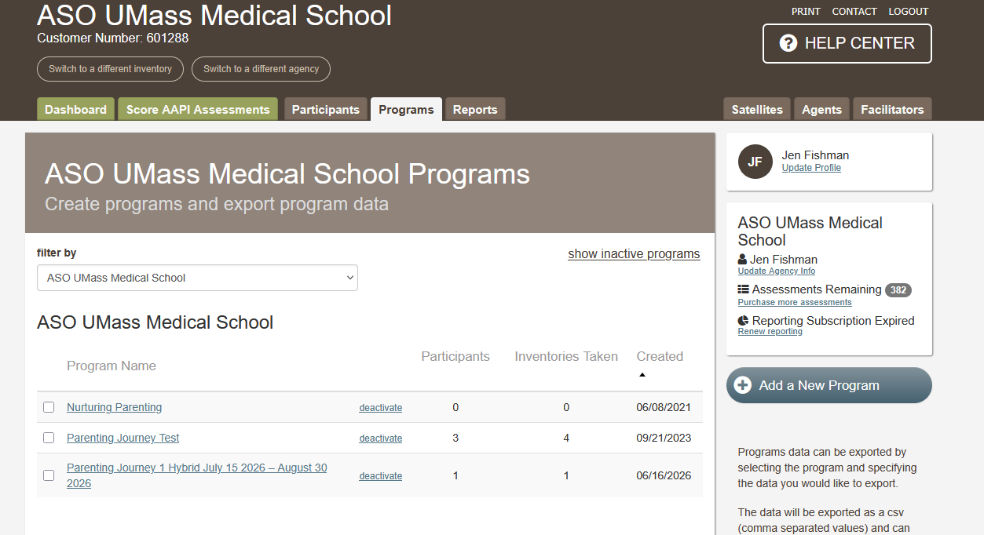
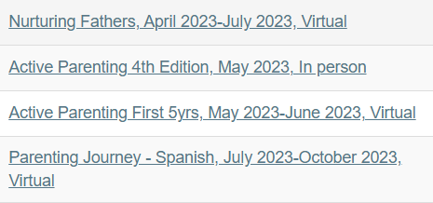
Correct Program (Class) Naming Convention
Correct Program Naming Conventions
Incorrect Program Naming Conventions
Be sure to list the specific evidence-based program
Ex. Nurturing Fathers, Parenting in America, Parenting Journey 1

Slide 5
Entering Family Member Data in Assessing Parenting
Absolutely NO PII should be entered into the assessing parenting website, this means the name of the family member and their full date of birth.
Entering the participants information:
  Use the Family Member’s ID (obtained from the CRM) for name. It can be entered once in the first name field: Ex. MBR1234
Entering the participants date of birth (DOB):
  For the DOB enter the month and day that the 1st assessment took place and enter the actual birth year of the family member
  Ex. If the assessment took place today (6/23/2026) enter 6/23/1983 today’s month, day, and the family member’s actual birth year.
Personally Identifiable Information (PII):
Data that can be used to distinguish or trace an individual's identity, either alone or when combined with other linked or linkable information.

Slide 6

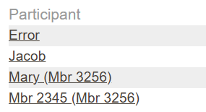
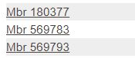

Personally Identifiable Information (PII)
What is PII in terms of AAPI Data Entry?
  Name (even if it is just the Family Member’s first or last name)
  Full DOB including month, day, and year. Birth year alone is not PII.
Correct Data Entry of ID in “Name” Field
Incorrect Data Entry of ID in “Name” Field
Note that Family Member ID in the CRM starts with “MBR” whereas Family ID starts with “FAM”
Be sure to use the Family Member ID

Slide 7
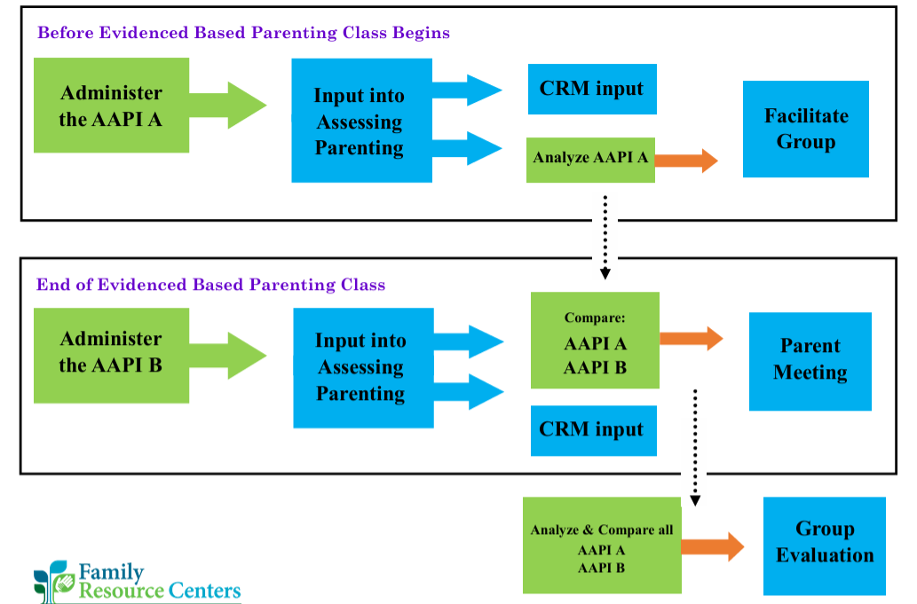
AAPI Process

Slide 8
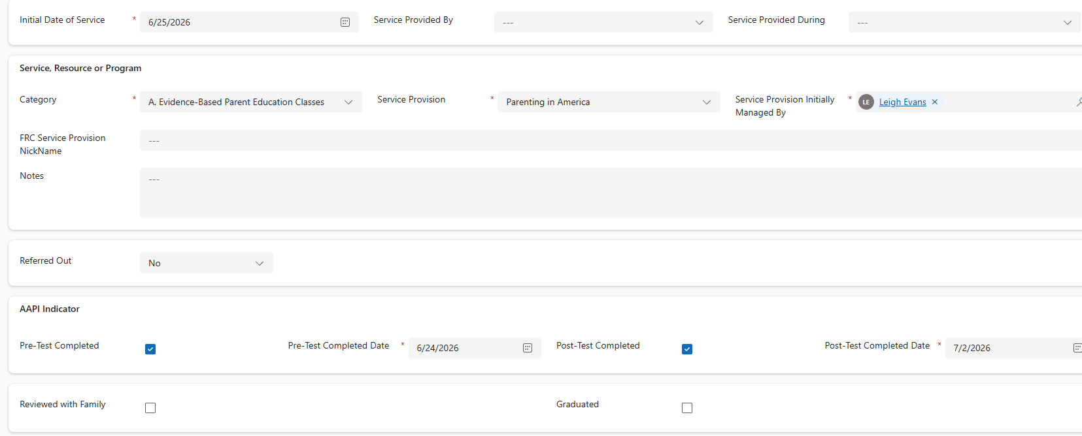
AAPI Data Entry in the CRM
Reminder: The AAPI is used for the following programs:
  Nurturing Parenting®, Parenting Journey (all types), and Active Parenting Classes
In the CRM, when you enter a service provision for the Family Member for the parenting class, AAPI options will appear. Be sure to complete them in the CRM as the steps are completed.

Slide 9
Additional Guidance on Form A (Pre-Test) Data Entry
If your FRC conducts AAPI Form A (Pre-Test) at a date prior to the family member’s first parenting program class date, enter the AAPI Form A administration in the CRM as the initial service provision for the parenting program under “Category A. Evidence-Based Parent Education Classes” and the date Form A was completed.
Each parenting program class date can then be entered as additional “Service Dates” under that service provision.
Be sure to check off the “Pre-Test Completed” AAPI indicator under the service provision in the CRM.

Slide 10
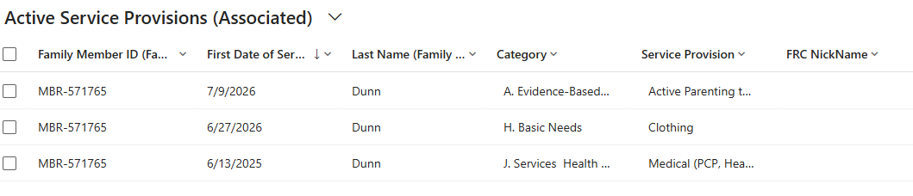
AAPI Data Entry in the CRM – Form B (Post-Test)
Once a family member completes AAPI Form B for a parenting program, be sure to check of the indicator “Post-Test Completed” under the main service provision screen.
Go to that Family Member → Services Provisions
You will see a list of all active service provision types for that family member.
Select the parenting program service provision, which will take you to that main service provision screen.
Within that record, check off the “Post-Test Completed” box and enter the date it was completed.

Slide 11
Screenshots for Reference

Slide 12
Adding a Program in Assessing Parenting

Slide 13
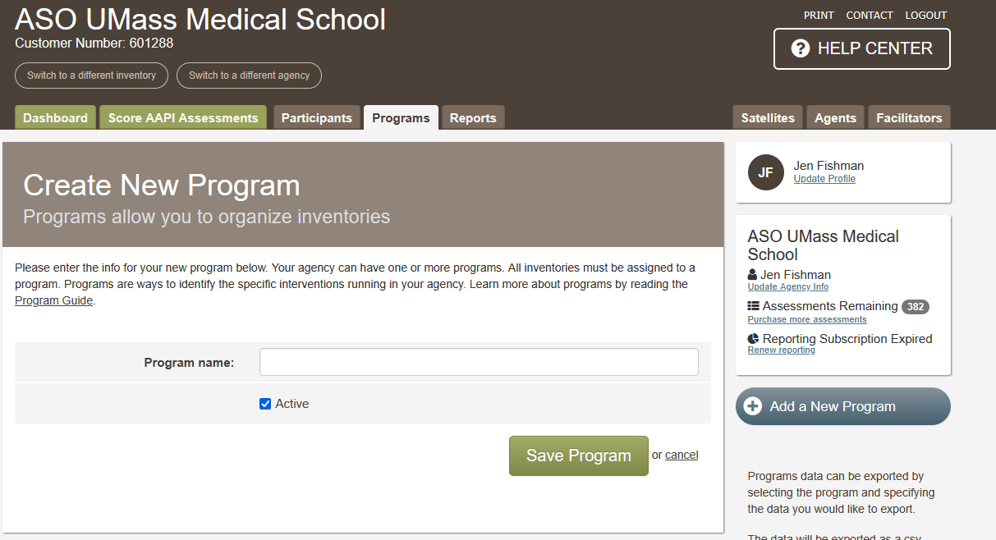
Naming a Program
Program (Class) Naming Convention
Class name, listing specific evidence-based program
Type: In-person, virtual, hybrid
Timeframe: month & year
Ex. Nurturing Fathers In-Person Feb – Mar 2022
Ex. Parenting Journey 1 Hybrid Sept 15 2022 – Nov 30 2022

Slide 14
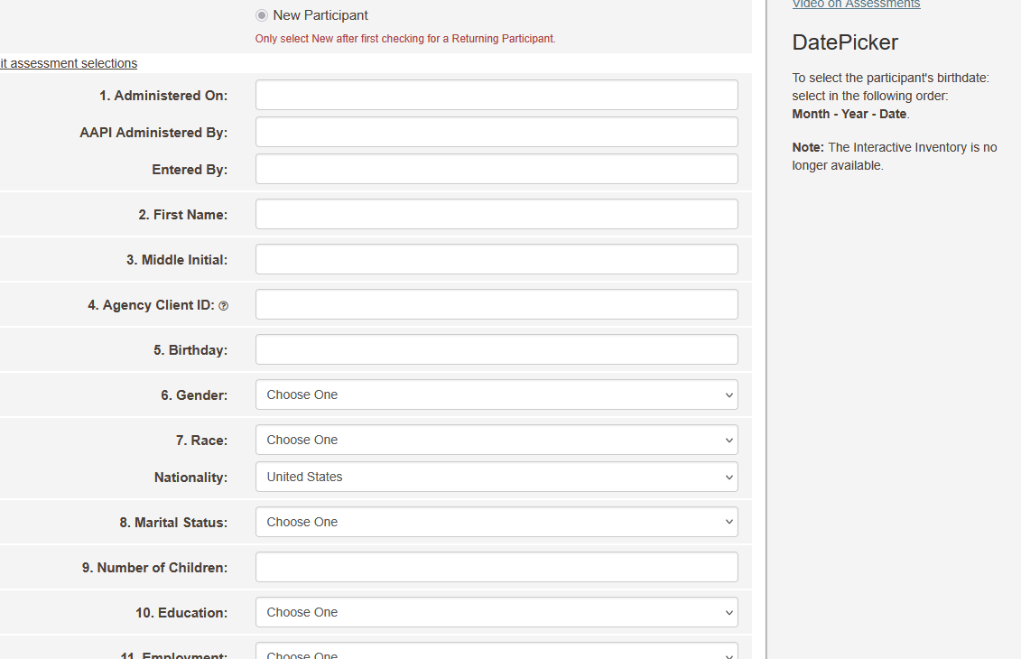
Entering Family Member ID in Name Field
First Name should be the participant’s Family Member ID from CRM
Ex. MBR1234
Birthday should be the month and day the first AAPI took place and the participant’s actual birth year
Ex. 6/23/1983

Slide 15
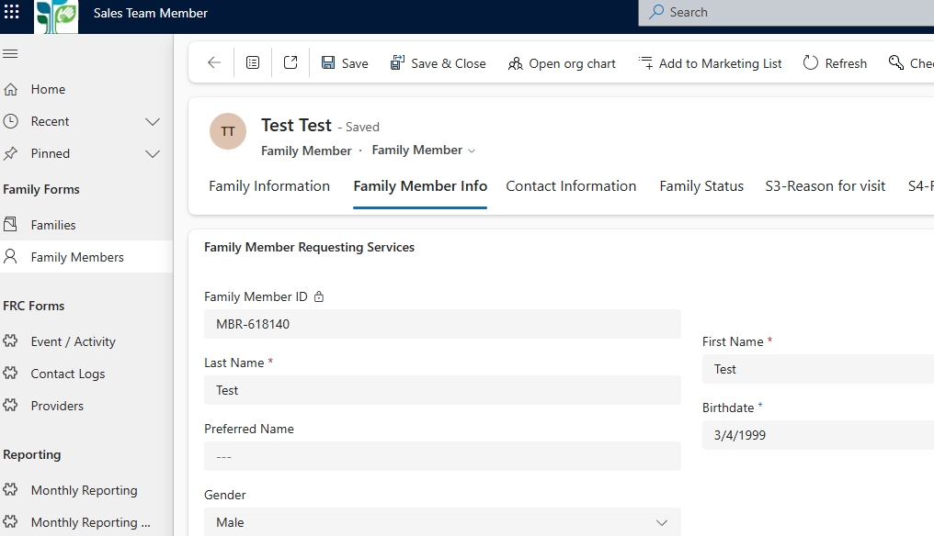
Finding Family Member ID in the CRM
Note that Family Member ID in the CRM starts with “MBR” whereas Family ID starts with “FAM”
Be sure to use the Family Member ID

Slide 16
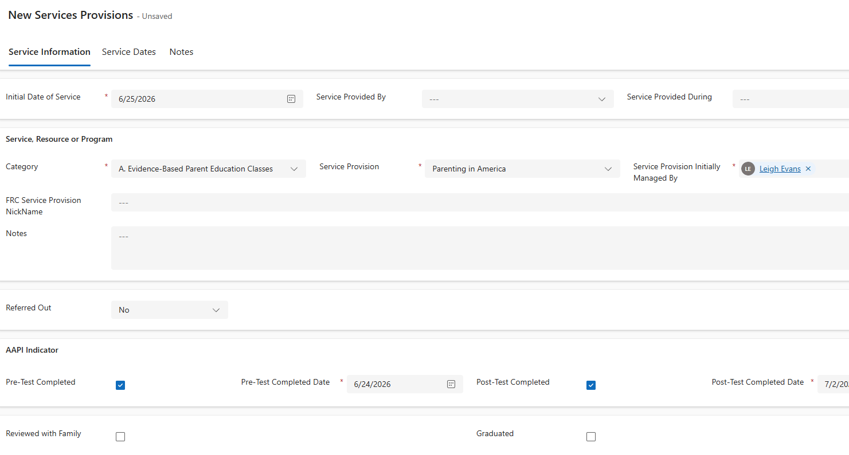
Finding AAPI Fields in the CRM New Service
In the CRM, when you enter a “New Services Provision” for the Family Member, select this option for the class and the AAPI Indicator options will pop up

Slide 17
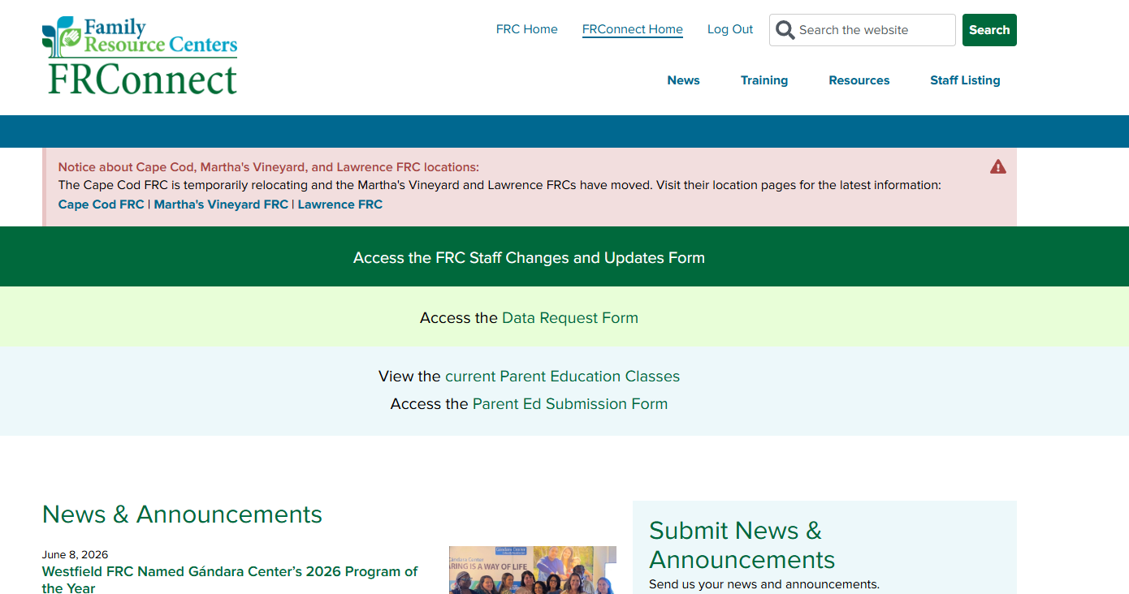
Finding AAPI Resources on FRConnect - 1
https://www.frcma.org/

Slide 18
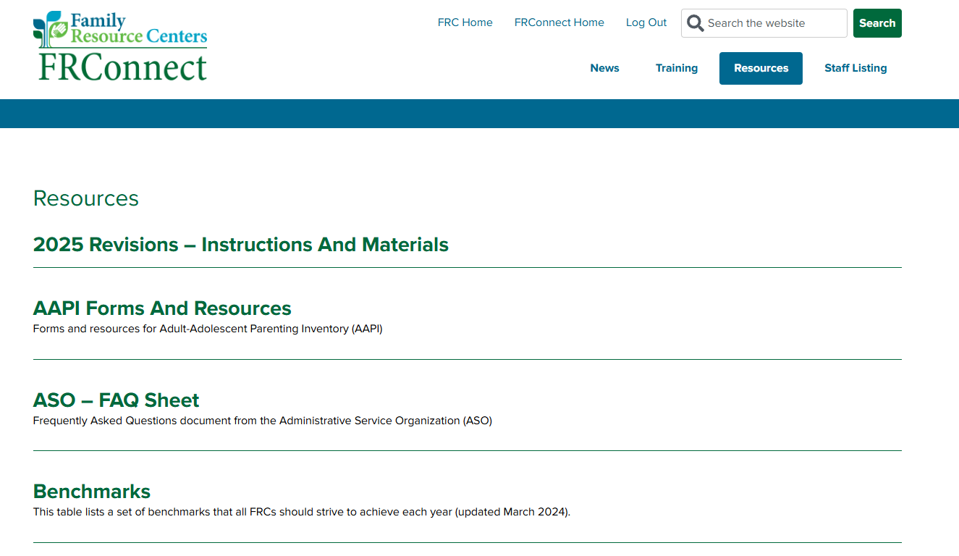
Finding AAPI Resources on FRConnect - 2

